Slide 1

CIT83104: ADVANCED WEB DESIGN AND DEVELOPMENT
By:
Mr. MANIRARORA Jean Marie Vianney
Course Code: CIT83104 & Name: ADVANCED WEB DESIGN AND DEVELOPMENT
1

Slide 2
CLASS INSTRUCTIONS
Please keep your phones aside during class sessions.
100% attendance is required for all classes.
Students are expected to practice effective time management.
Participation in all academic activities is mandatory, including:
Quizzes
In-class activities
Individual assignments
Group assignments
Presentations
Note: Failure to attend or participate in these activities may affect your overall performance.

Slide 3
MODULE OVERVIEW
Module Code: CIT83104
Title: Advanced Web Design and Development
Credits: 15
Year: 3rd Year
Prerequisite: Introduction to Web Design and Development
Total Study Hours: 150 (Lectures, Labs, Assignments, Self-study, etc.)

Slide 4
MODULE AIMS
Prepare students for professional web development
Blend theoretical knowledge with practical implementation
Focus on interactive, database-backed, and maintainable web applications

Slide 5
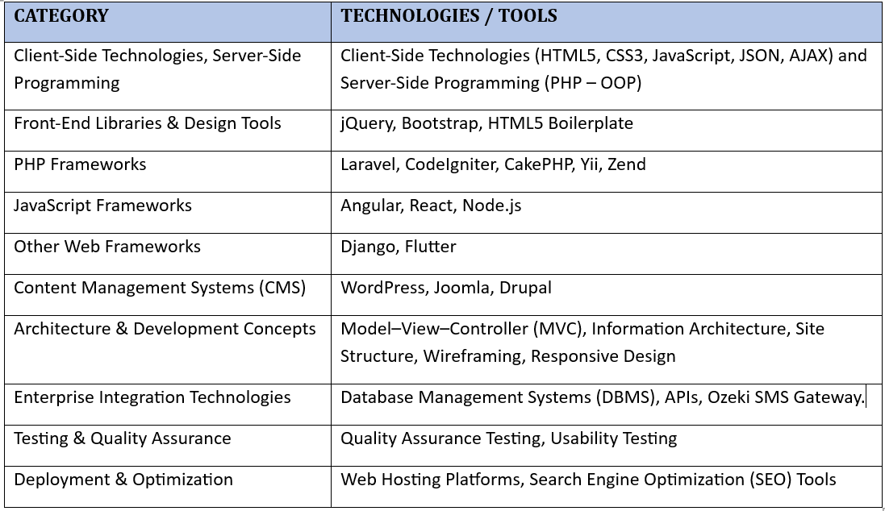
KEY TECHNOLOGIES & TOOLS

Slide 6


Slide 7
MODULE CONTENTS
HTML, CSS, JavaScript, layout techniques, and other industry-standard practices.
scripting technologies to create dynamic and interactive websites.
Professional quality portfolio of web design work.
Back-end interactivity with front-end to build web applications
build Dynamic websites utilizing the most current versions of industry-standard applications and tools

Slide 8
CHAP 2: SCRIPTING TECHNOLOGIES TO CREATE DYNAMIC AND INTERACTIVE WEBSITES.

Slide 9
Introduction to Scripting Technologies
Scripting technologies are programming tools used to make websites dynamic and interactive.
Instead of showing static content only, scripts allow websites to:
Respond to user actions
Validate forms
Update content without reloading
Communicate with servers
Examples of scripting languages
JavaScript – runs in the browser (client-side)
PHP – runs on the web server (server-side)
Python
JAVA
Etc.

Slide 10
1. Introduction to PHP
PHP (Hypertext Preprocessor) is a server-side scripting language used to create dynamic and interactive web pages.
It runs on the web server and sends the result to the user's browser as HTML.
PHP is commonly used for:
Web applications
Form processing
Database interaction
User authentication systems

Slide 11
2. Features of PHP
Main features of PHP:
Open source (free to use)
Easy to learn
Runs on many platforms (Windows, Linux, Mac)
Supports many databases (MySQL, PostgreSQL, Oracle)
Embedded in HTML
Fast execution on servers

Slide 12
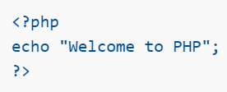
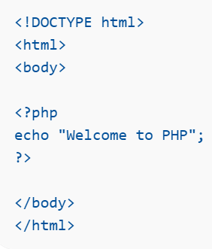
3. Basic Structure of a PHP Script
A PHP script starts with:
<?php // PHP code ?>
Example:
Example inside HTML:

Slide 13
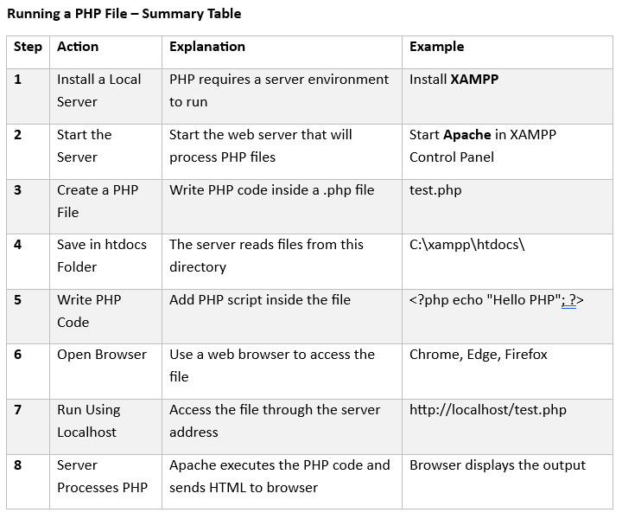

Slide 14
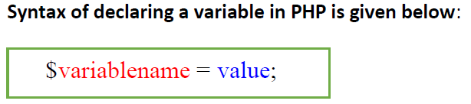
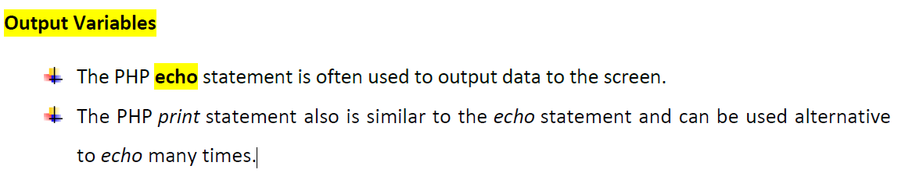
4. PHP Variables
Variables store data values.
Rules rename variables in PHP:
Start with $
Cannot start with numbers
Case-sensitive
Example:
<?php $name = "John"; $age = 25; echo $name; ?>

Slide 15
PHP is a Loosely Typed Language
PHP is a loosely typed language, and we do not require to declare the data types of variables, rather PHP assumes it automatically by analyzing the values. The same happens while conversion.
No variables are declared before they are used.
It automatically converts types from one type to another
whenever required.

Slide 16
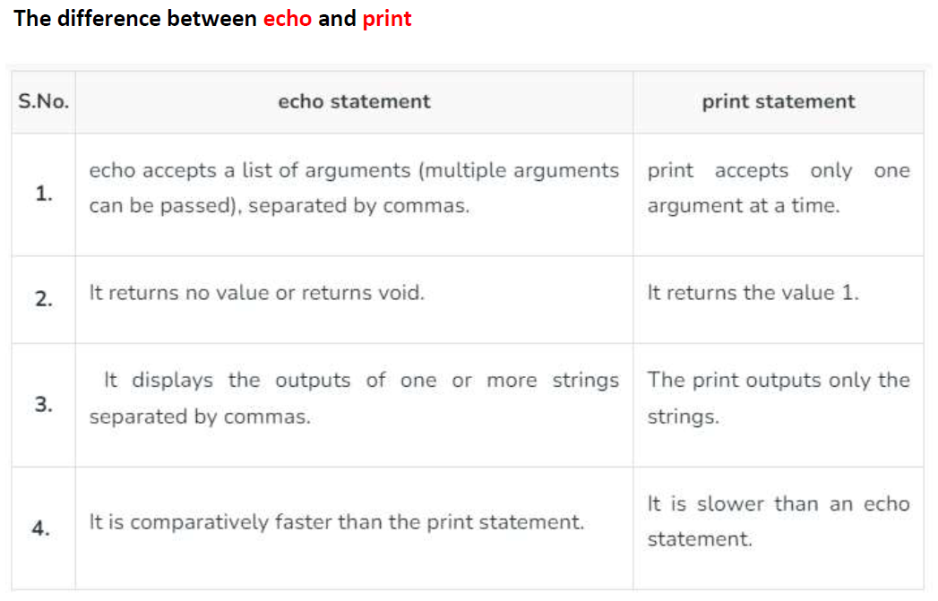

Slide 17
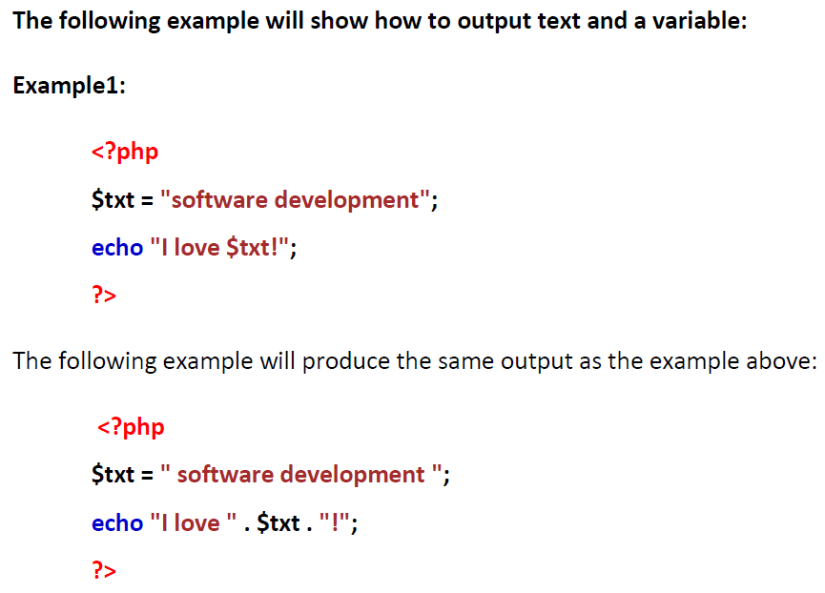

Slide 18
Example2 :
The following example will output the sum of two variables:
<?php
$x = 5;
$y = 4;
echo $x + $y;
?>

Slide 19
Example3:
<!DOCTYPE html>
<html>
<body>
<?php
$txt1 = "Learn PHP";
$txt2 = "W3Schools.com";
$x = 5;
$y = 4;
print "<h2>" . $txt1 . "</h2>";
print "Study PHP at " . $txt2 . "<br>";
print $x + $y;
?>
</body>
</html>
Output
Study PHP at W3Schools.com
9

Slide 20
PHP Variable: Declaring string, integer and float
Let's see the example to store string, integer and float values in PHP variables.
File: variable1.php
<?php
$str="hello string";
$x=200;
$y=44.6;
echo "string is: $str <br/>";
echo "integer is: $x <br/>";
echo "float is: $y <br/>";
?>
Output:
string is: hello string
integer is: 200
float is: 44.6

Slide 21
PHP Variables are: case sensitive
In PHP, variable names are case sensitive. So variable name "color" is different from Color, COLOR, COLor etc.
File: variable3.php
<?php
$color="red";
echo "My car is " . $color . "<br>";
echo "My house is " . $COLOR . "<br>";
echo "My boat is " . $coLOR . "<br>";
?>
Output:
My car is red
Notice: Undefined variable: COLOR in C:\wamp\www\variable.php on line 4
My house is
Notice: Undefined variable: coLOR in C:\wamp\www\variable.php on line 5
My boat is

Slide 22
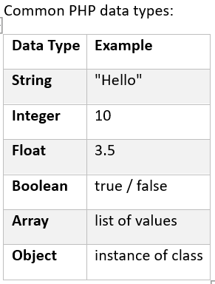
5. PHP Data Types:

Slide 23
6. PHP Operators
PHP Operator is a symbol which is used to perform operations on operands.
Operators are used to perform operations on variables and values.
For example:
$num=10+20; //+ is the operator and 10,20 are operands
PHP divides the operators in the following groups:
✓ Arithmetic operators
✓ Assignment operators
✓ Comparison operators
✓ Increment/Decrement operators
✓ Logical operators
✓ String operators
✓ Array operators

Slide 24
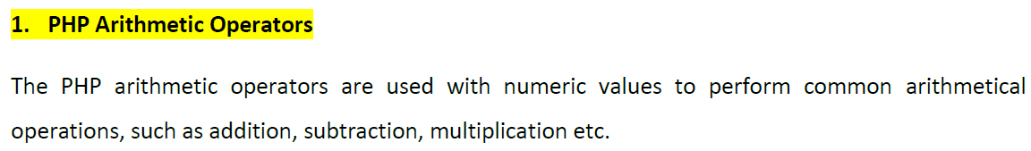
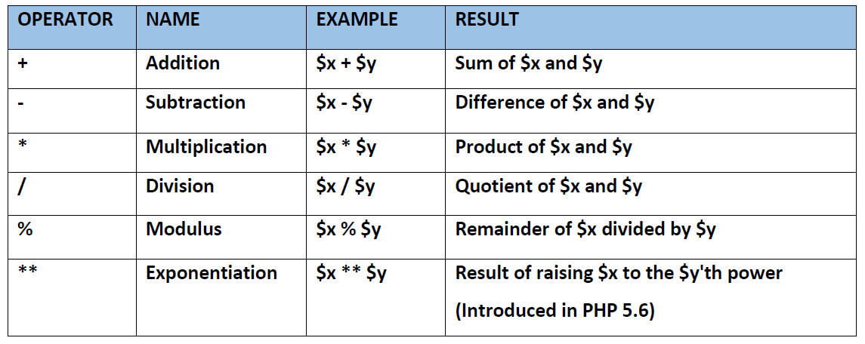

Slide 25
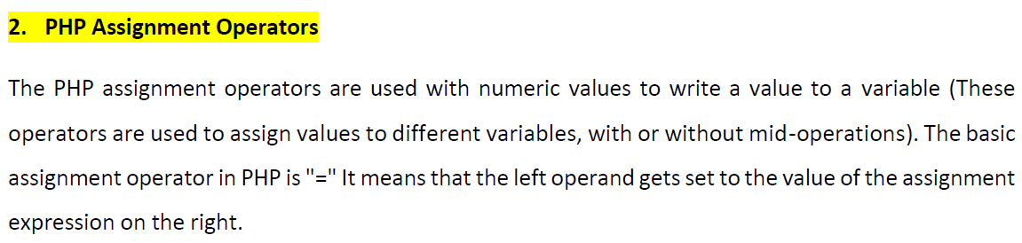
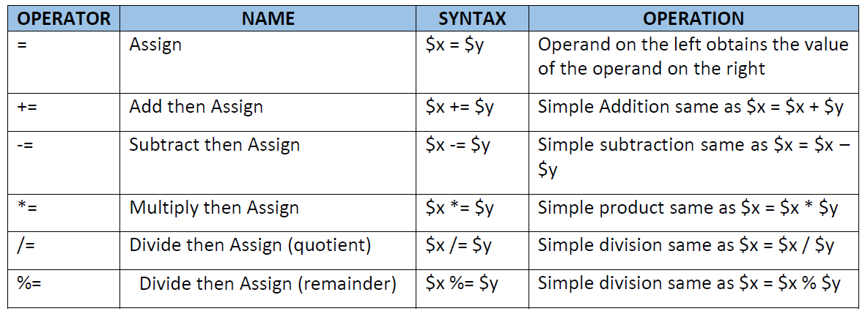

Slide 26
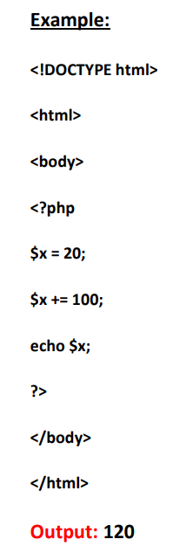
Example:

Slide 27
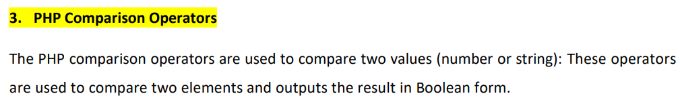
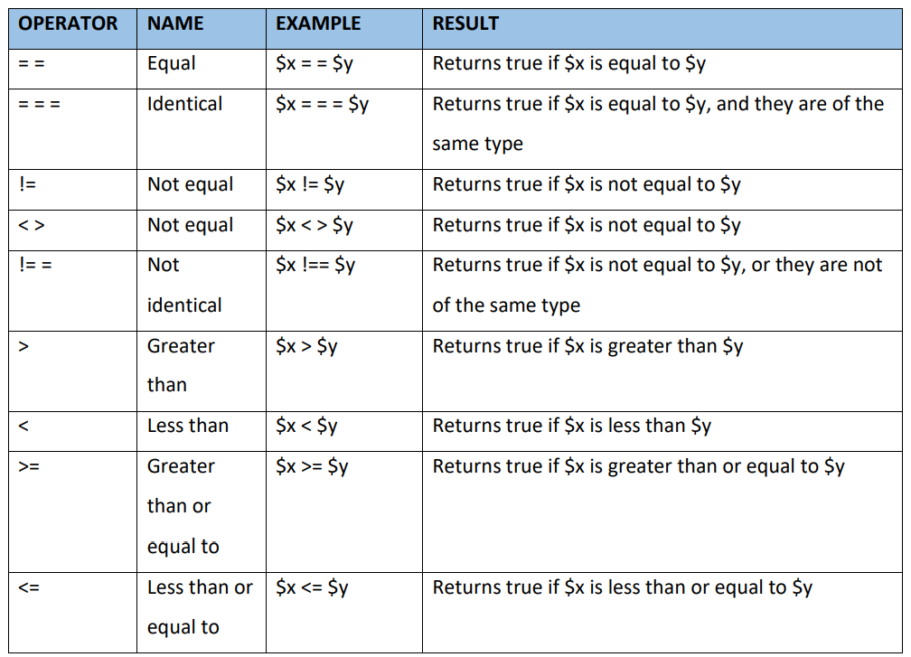
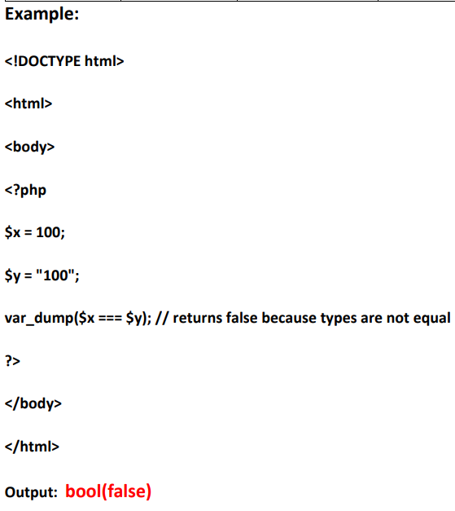

Slide 28
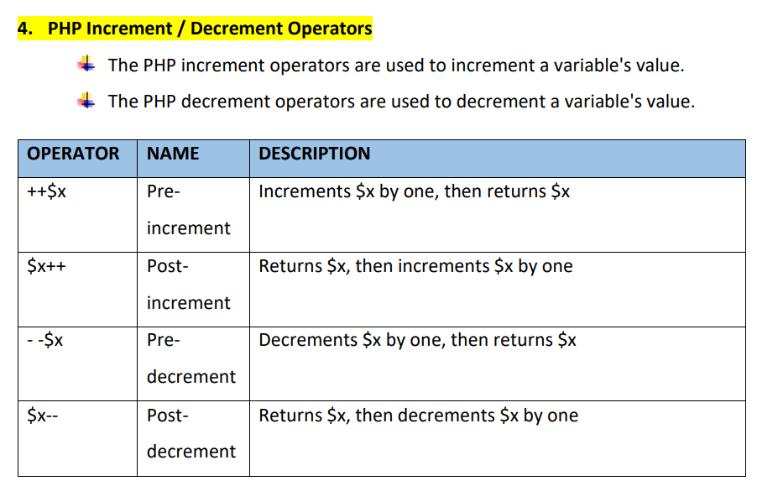

Slide 29
Examples:
<!DOCTYPE html>
<html>
<body>
<?php
$x = 10;
echo ++$x;
?>
</body>
</html>
Output: 11
<!DOCTYPE html>
<html>
<body>
<?php
$x = 10;
echo $x++;
?>
</body>
</html>
Output: 10

Slide 30
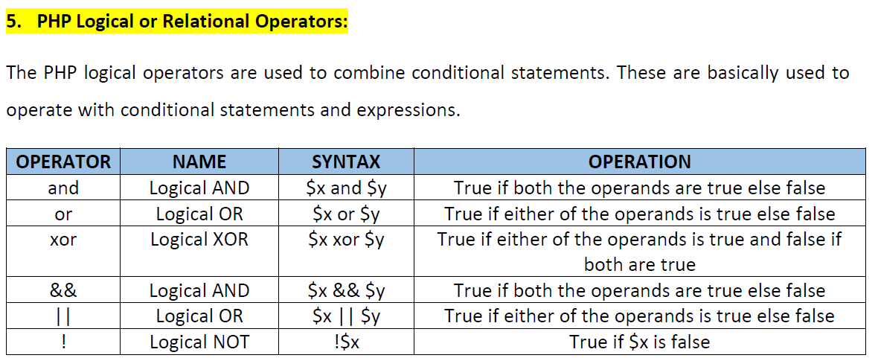

Slide 31
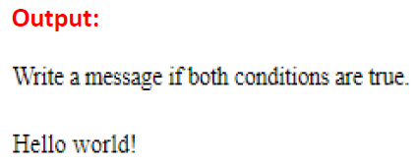
Example:
<!DOCTYPE html>
<html>
<body>
<h1>The and Operator</h1>
<p>Write a message if both conditions are true.</p>
<?php
$x = 100;
$y = 50;
if ($x == 100 and $y == 50) {
echo "Hello world!";
}
?>
</body>
</html>

Slide 32
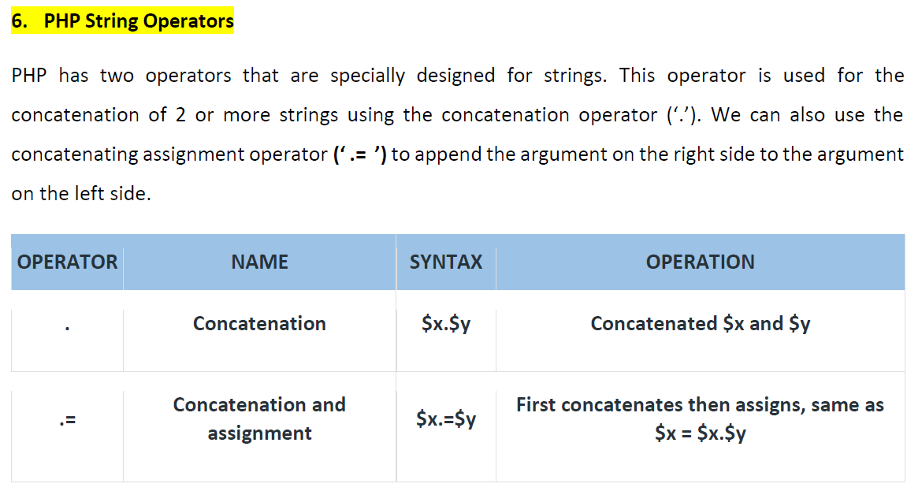

Slide 33
Examples:
<!DOCTYPE html>
<html>
<body>
<?php
$txt1 = "Hello";
$txt2 = " world!";
$txt1 .= $txt2;
echo $txt1;
?>
</body>
</html>
Output:
Hello world!
<?php
$name="John";
$lastName="Travolta";
echo $name." ".$lastName; // Outputs John Travolta
$a="Hello";
$a .= " John!";
echo $a;
// Outputs Hello John!
?>

Slide 34
7. PHP Comments
A comment is simply text that is ignored by the PHP engine.
The purpose of comments is to make the code more readable.
PHP comments can be used to describe any line of code so that other developer can
understand the code easily.
It can also be used to hide any code.
We use comments to understand the functionality of the codes in a program.

Slide 35
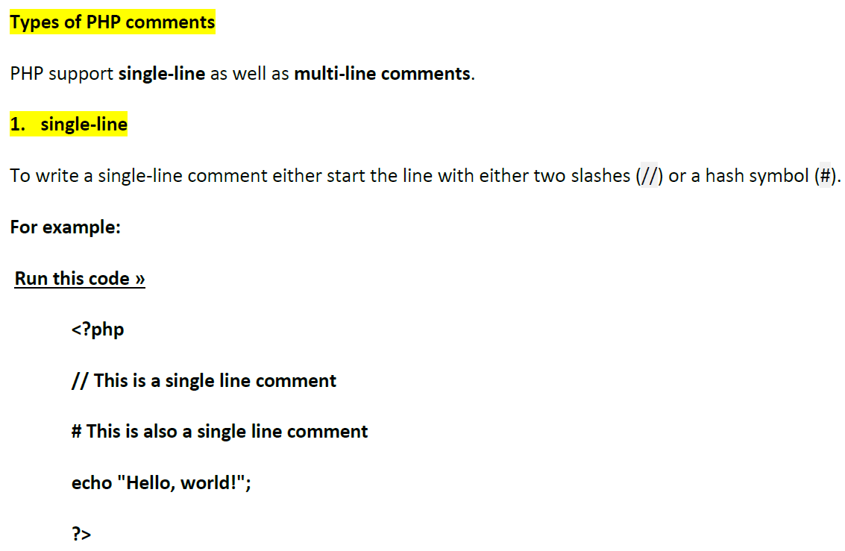

Slide 36
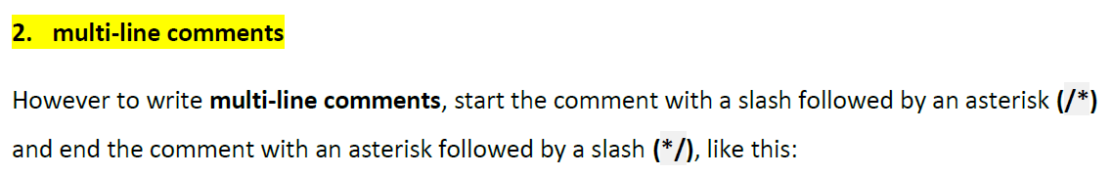
Example:
Run this code »
<?php
/*
This is a multiple line comment block
that spans across more than
one line
*/
echo "Hello, world!";
?>

Slide 37
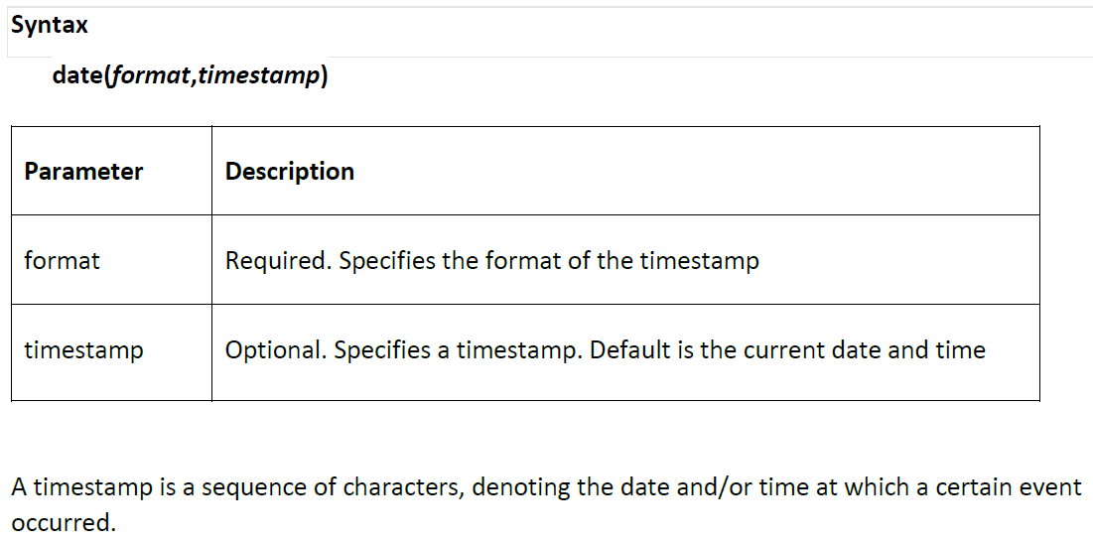
8. PHP date and time
The PHP date() function is used to format a date and/or a time
== built-in PHP function that formats the current date and time..
The PHP date() function formats a timestamp to a more readable date and time.

Slide 38
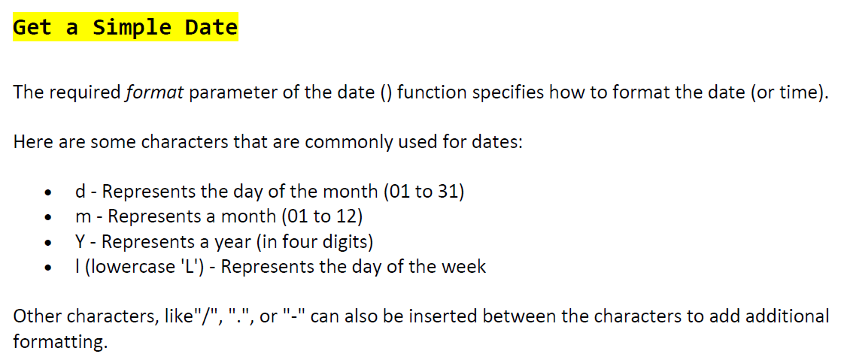

Slide 39
<?php echo "Today is " . date("Y/m/d") . "<br>"; echo "Today is " . date("Y.m.d") . "<br>"; echo "Today is " . date("Y-m-d") . "<br>"; echo "Today is " . date("l"); ?>
Format characters used:
Y → 4-digit year (e.g., 2026)
m → 2-digit month (01–12)
d → 2-digit day of the month (01–31)
l → full textual representation of the day of the week (e.g., Monday)
<br> → adds a line break in HTML
Example Output (Assuming today is March 8, 2026, Sunday)
Today is 2026/03/08 Today is 2026.03.08 Today is 2026-03-08 Today is Sunday

Slide 40
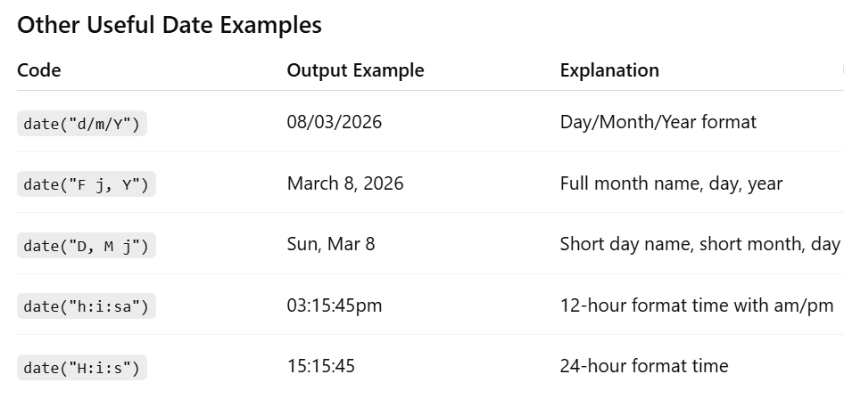

Slide 41
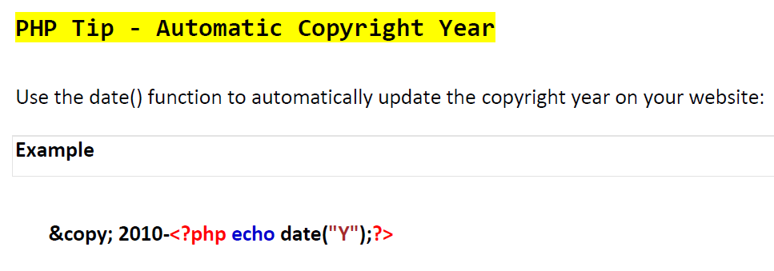

Slide 42
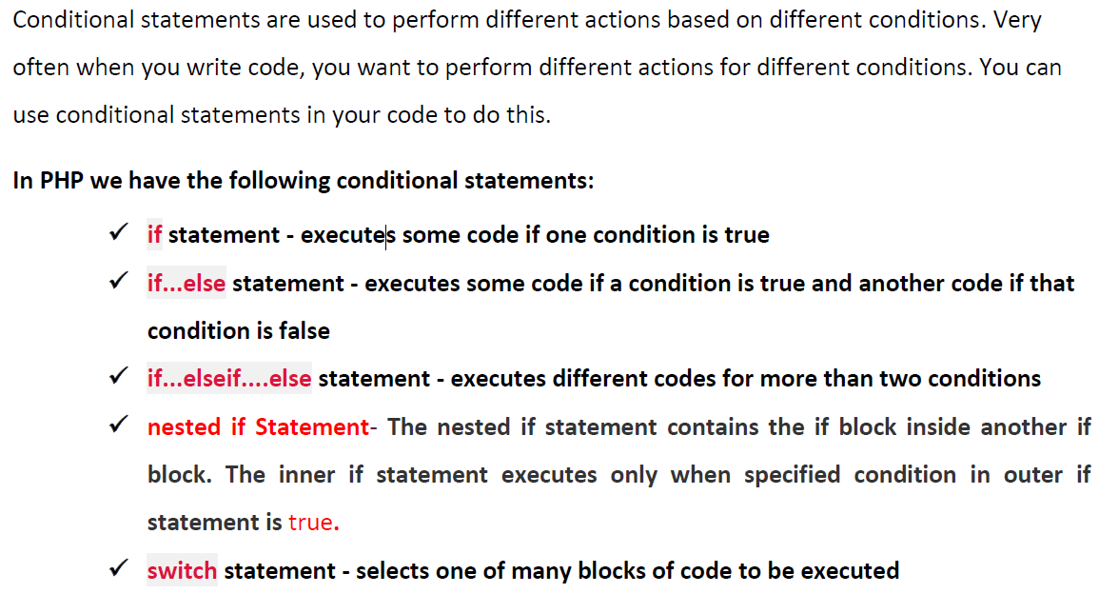
9. PHP Conditional Statements

Slide 43
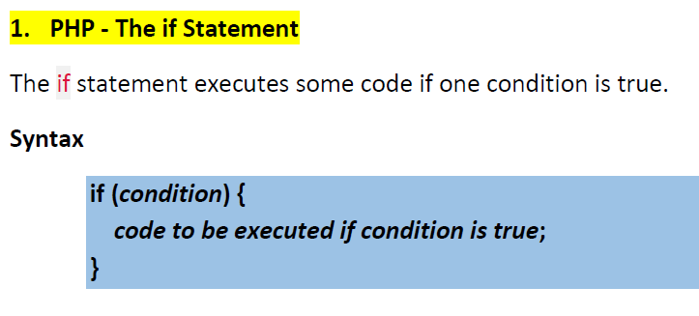

Slide 44
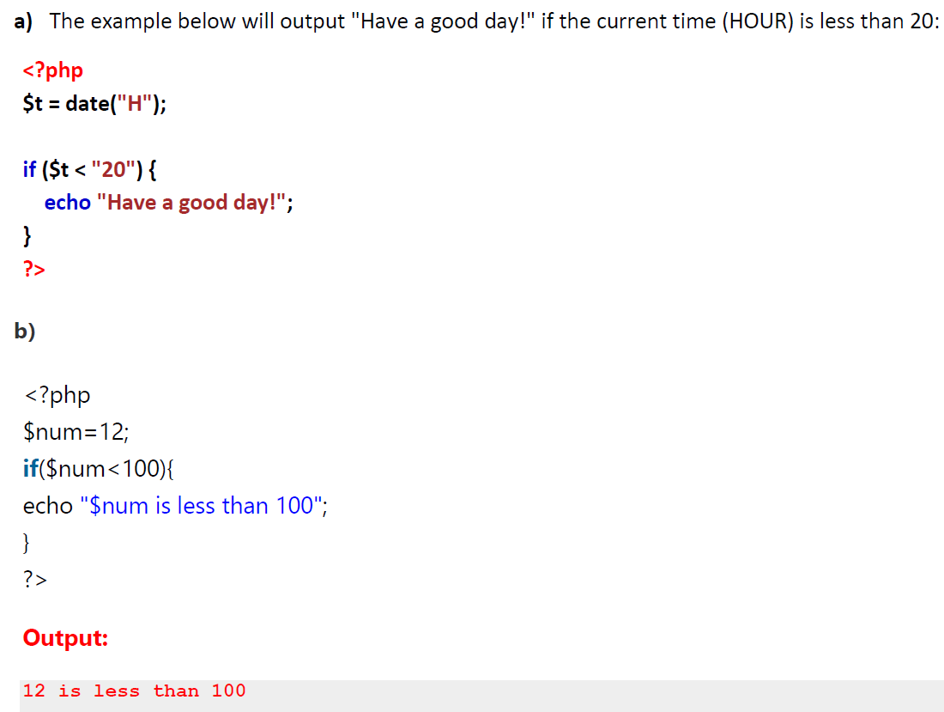

Slide 45
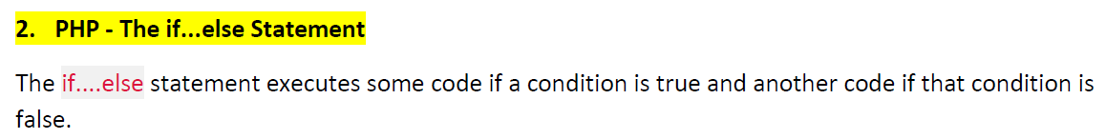
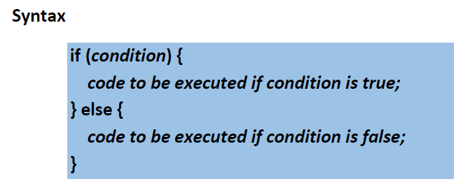

Slide 46
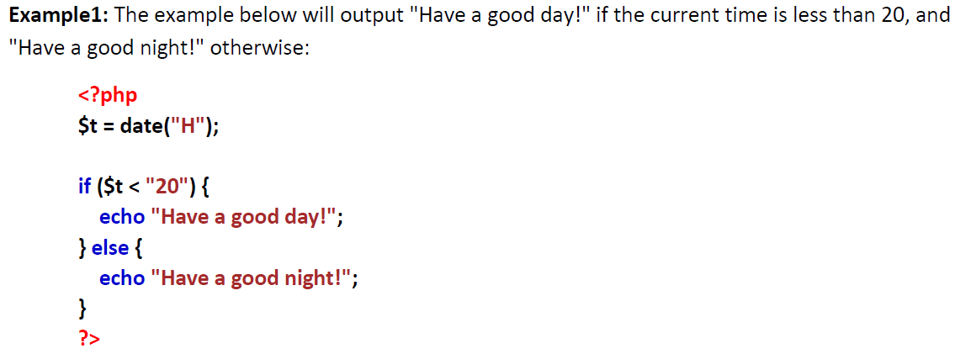
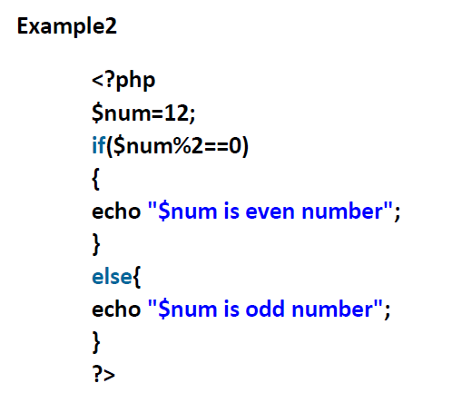

Slide 47
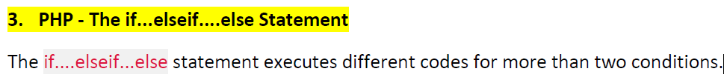
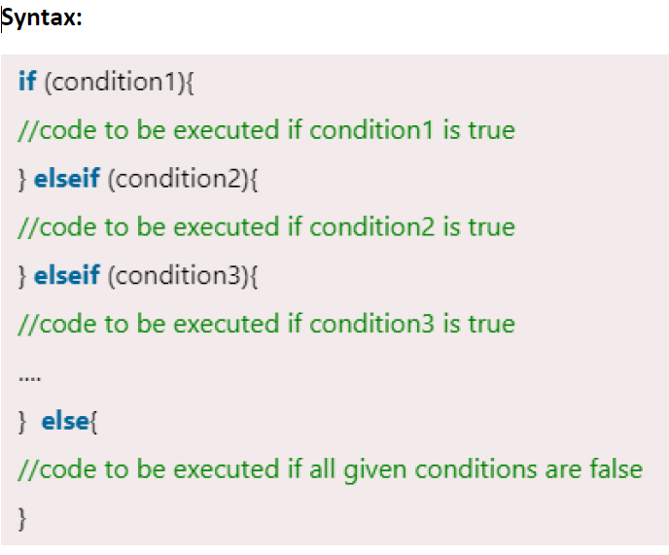

Slide 48
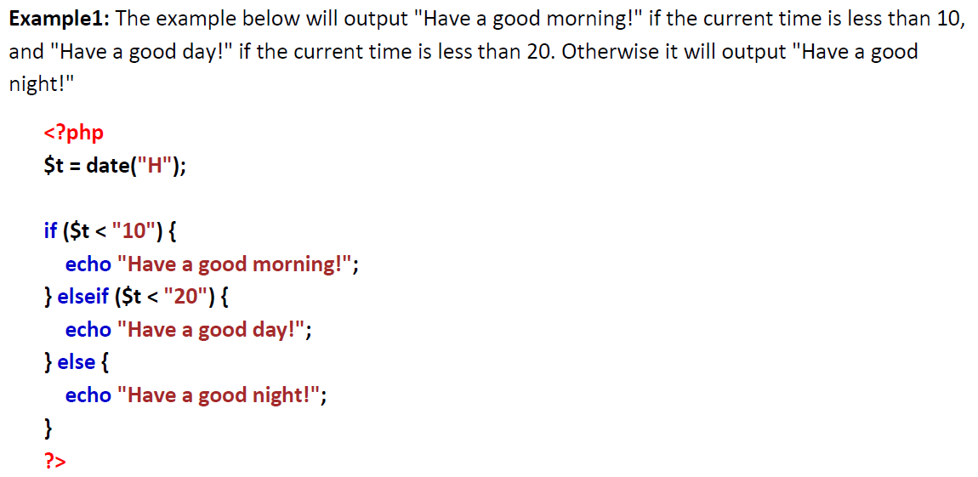

Slide 49
Example2:
<?php
$marks=69;
if ($marks<33){
echo "fail";
}
else if ($marks>=34 && $marks<50) {
echo "D grade";
}
else if ($marks>=50 && $marks<65) {
echo "C grade";
}
else if ($marks>=65 && $marks<80) {
echo "B grade";
}
else if ($marks>=80 && $marks<90) {
echo "A grade";
}
else if ($marks>=90 && $marks<100) {
echo "A+ grade";
}
else {
echo "Invalid input";
}
?>
Output: B Grade

Slide 50
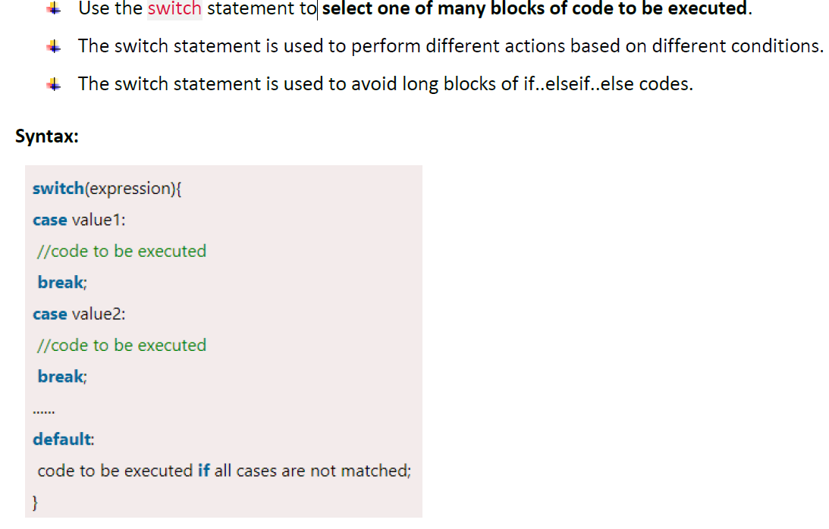
4. PHP switch Statement

Slide 51
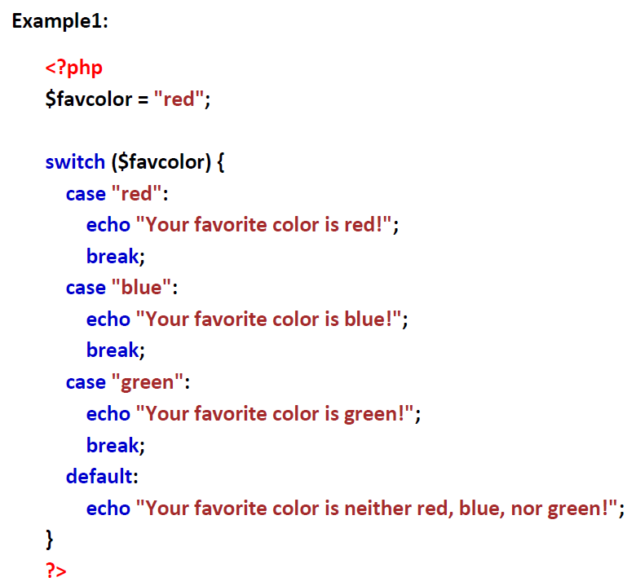

Slide 52
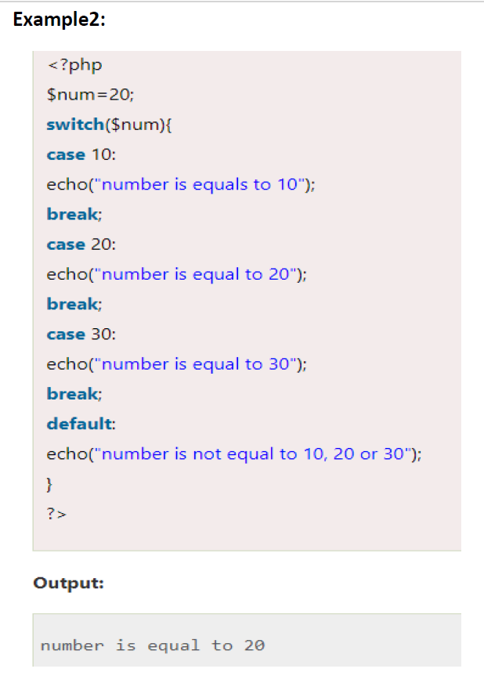

Slide 53
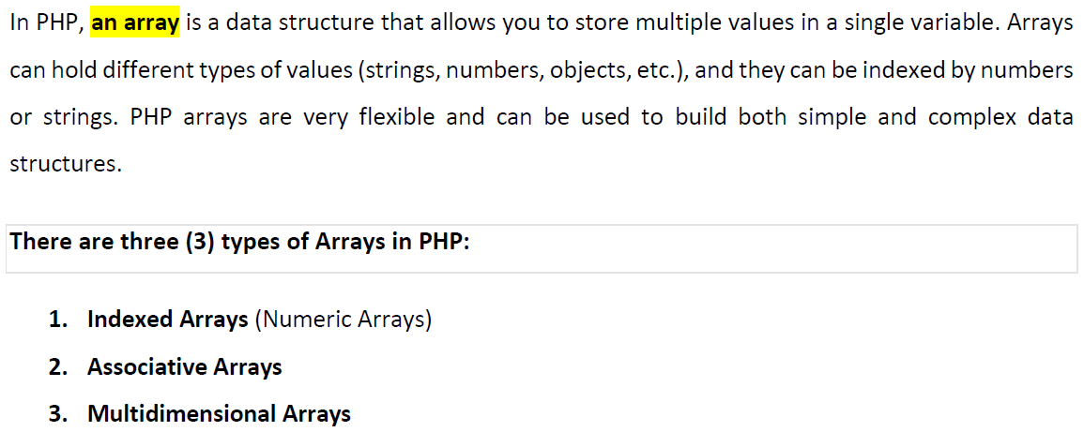
10. PHP Arrays

Slide 54
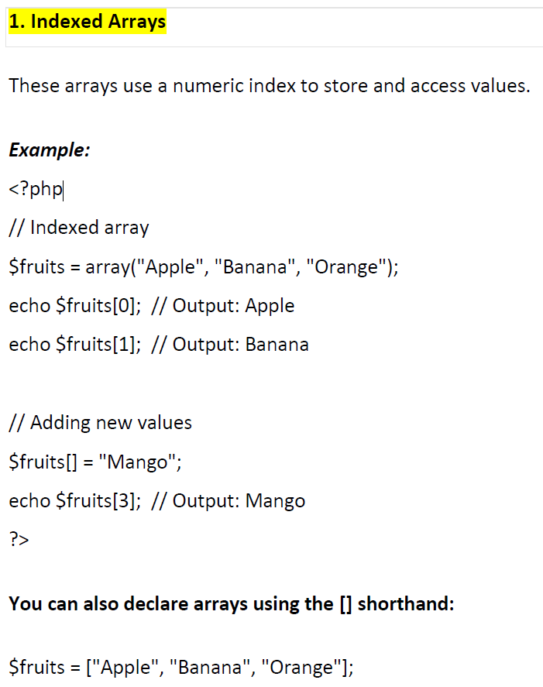

Slide 55
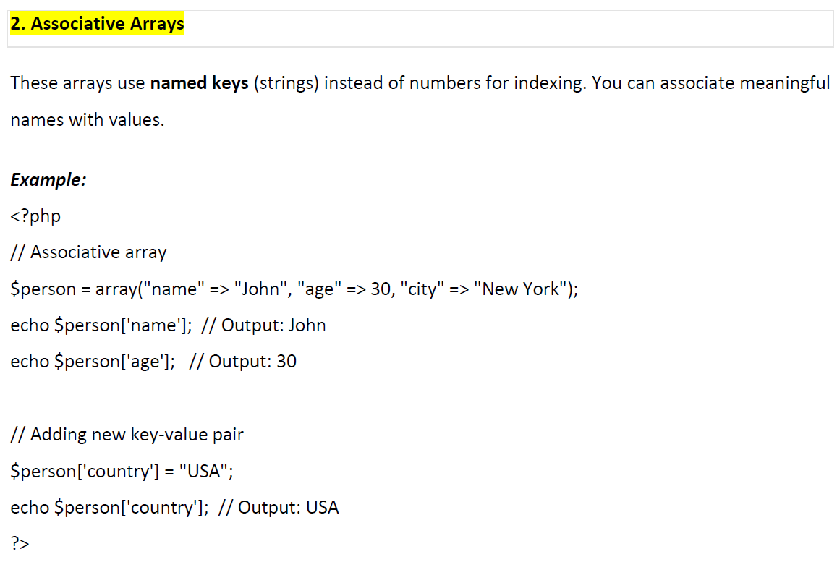

Slide 56
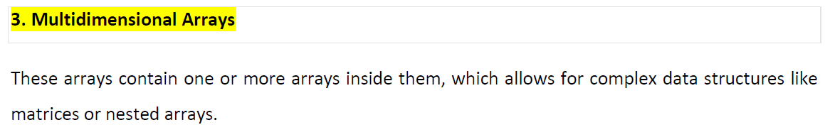
Example:
<?php
// Multidimensional array
$products = array(
array("Laptop", "HP", 1000),
array("Phone", "Samsung", 700),
array("Tablet", "Apple", 800)
);
// Accessing multidimensional array elements
echo $products[0][0]; // Output: Laptop
echo $products[1][1]; // Output: Samsung
echo $products[2][2]; // Output: 800
?>

Slide 57
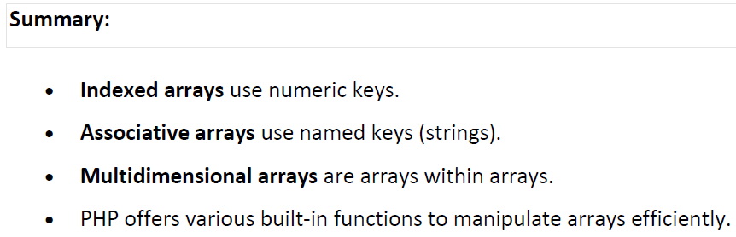

Slide 58
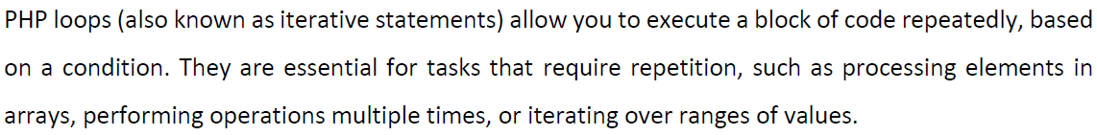
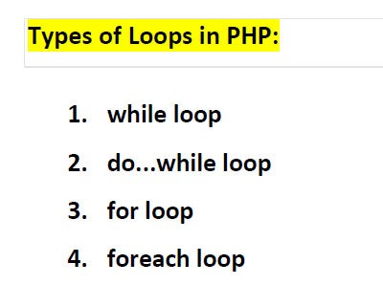
11. PHP Loops -PHP Iterative statements

Slide 59
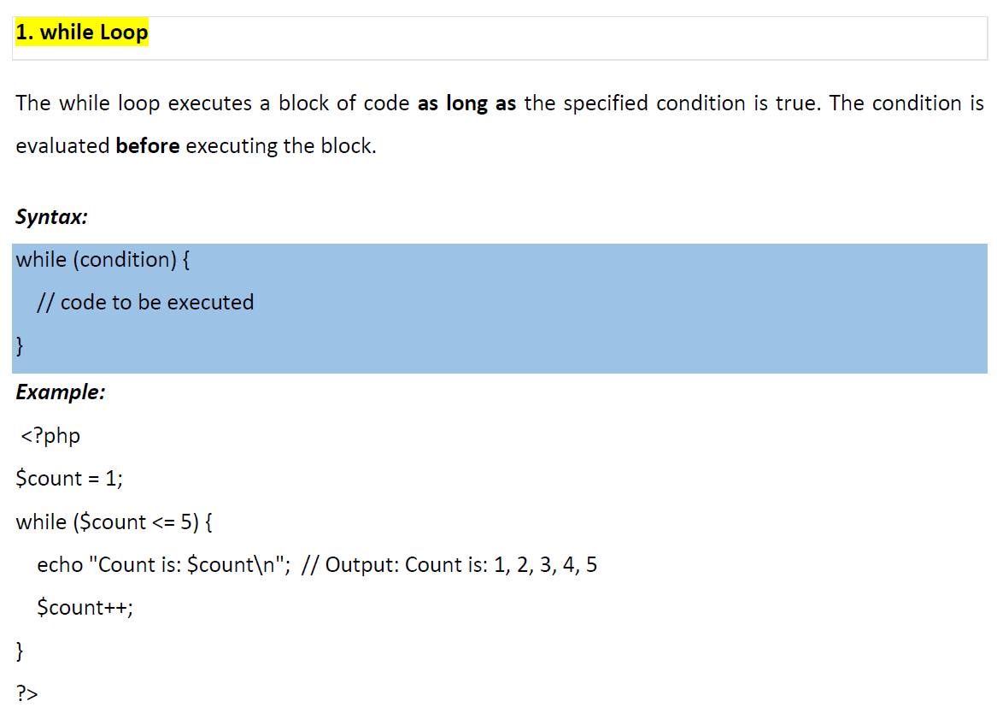

Slide 60
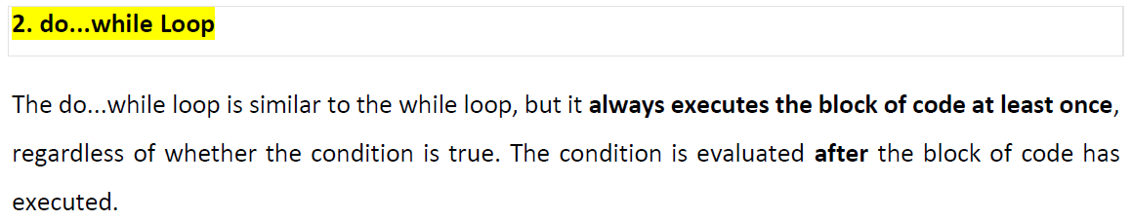

Slide 61
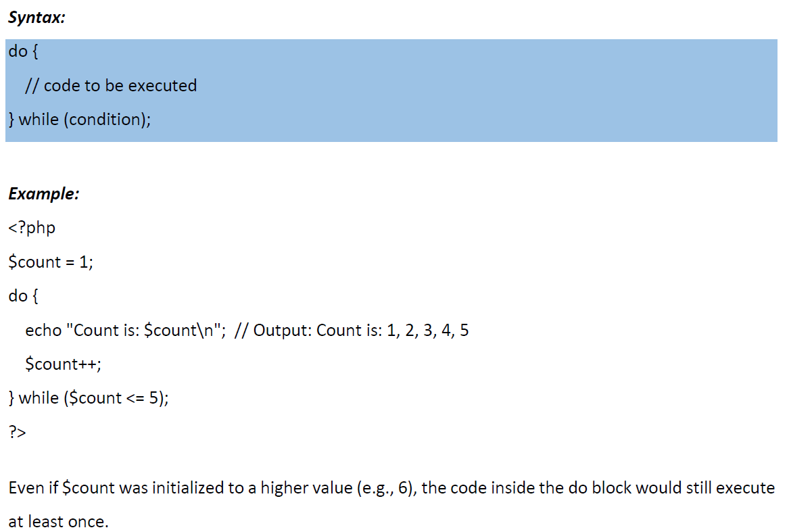

Slide 62


Slide 63


Slide 64


Slide 65

12. PHP Function

Slide 66


Slide 67


Slide 68


Slide 69


Slide 70




Slide 71




Slide 72
13. PHP Superglobal Variables
What are Superglobal Variables?
Superglobal variables are built-in PHP variables that are accessible from anywhere in a script (inside functions, classes, and global scope) without needing to declare them as global.
They are mainly used to collect data from forms, sessions, cookies, and server information.

Slide 73

Here is a clear summary table for the PHP superglobals variables

Slide 74

Quick memory tip (for exams):
GET → URL data
POST → Form data
SESSION → Server storage
COOKIE → Browser storage
REQUEST → Combination of GET + POST + COOKIE

Slide 75
<!DOCTYPE html>
<html>
<head>
<title>PHP User Input Example</title>
</head>
<body>
<h2>User Registration Form</h2>
<form method="post">
Name:
<input type="text" name="name" required>
<br><br>
Email:
<input type="email" name="email" required>
<br><br>
Age:
<input type="number" name="age" required>
<br><br>
<input type="submit" name="submit" value="Submit">
</form>
</body>
</html>
Complete Example: Receiving User Input in PHP
<?php
// Check if the form was submitted
if(isset($_POST['submit'])){
// Receive user inputs
$name = $_POST['name'];
$email = $_POST['email'];
$age = $_POST['age'];
// Display the inputs
echo "<h3>User Information</h3>";
echo "Name: " . $name . "<br>";
echo "Email: " . $email . "<br>";
echo "Age: " . $age . "<br><br>";
}
?>
File name: form.php

Slide 76
<?php
if(isset($_POST['submit'])){
$age = $_POST['age'];
if($age >= 18){
echo "You are an Adult";
} else {
echo "You are a Minor";
}
}
?>
<!DOCTYPE html>
<html>
<body>
<h2>Age Checker</h2>
<form method="post">
Age:
<input type="number" name="age" required>
<br><br>
<input type="submit" name="submit" value="Check Age">
</form>
</body>
</html>
Example: Check User Age Using if...else

Slide 77
END OF CHAP 2

